Slide 1
Evaluation of Time Series Forecasting models for Treasury Services
1

Slide 2

Machine Learning is transforming the industry!
Banking is no difference!
In Treasury Service
Cash management
Optimize the cash buffer
Maintain the right balance
Predict clients’ operating liquidity requirements

Slide 3
Objective
Apply five time-series forecasting models in machine learning and deep learning
Produce forecasting for a valid use case
Recommend on suitability and provide best practices of these models
Deliverables
Time-series forecasting framework of five models (Prophet, ARIMA, GARCH, CNN and RNN)

Slide 4
Machine Learning and Deep Learning
Interpretability
ARIMA
Machine Learning
Prophet
GARCH
CNN
Deep Learning
RNN
Complexity

Slide 5
Agenda
Motivation and Objective
Walkthrough for Five Models
Hyper-parameter tuning
Use case and benchmarking
Conclusions and further application

Slide 6
Prophet
6

Slide 7

Prophet - Motivation
Prophet Overview
“We present a forecasting approach based on a decomposable model with interpretable parameters that can be intuitively adjusted by the analyst.”
-- Forecasting at Scale

Slide 8
Prophet - Overview
Prophet Overview
Open source library by Facebook’s Core Data Science team
Underlying calculation engine is Stan
Interfaces available in R and Python
Designed for analyst with domain knowledge
Visualization support

Slide 9
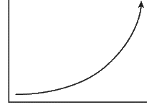
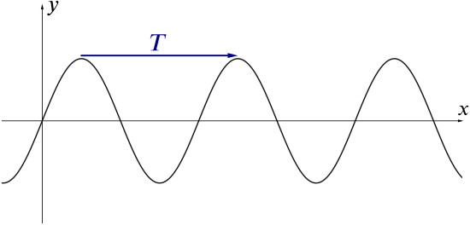
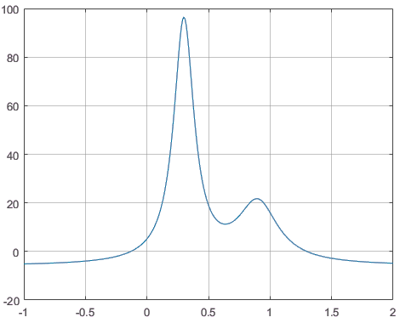
Prophet - Overview
Y(t) = g(t) + s(t) + h(t) + e
Growth Model : g(t)
Periodic Seasonality : s(t)
Holidays and Events h(t)

Slide 10
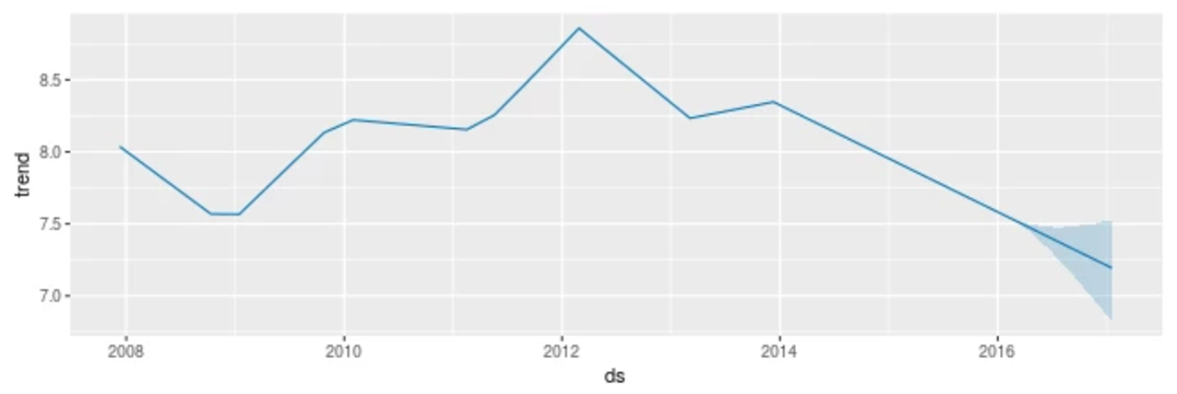
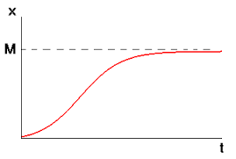
Prophet - Technical Aspects
Linear : define or automatically generate change points
Logistic : define a constant or linear capacity

Slide 11
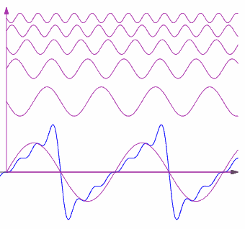
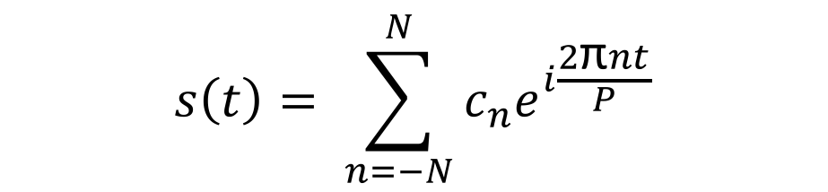
Prophet - Technical Aspects
$$s\left(t\right)= \sum_{n=−N}^{N}{c_{n}e^{i\frac{2\text{π}nt}{P}}}$$
P is the period
N is the order of series
Weekly (P=7, N=3)
Yearly (P=365.25, N=10)
Larger N allows to fit more complex seasonal functions
But easier to overfit

Slide 12
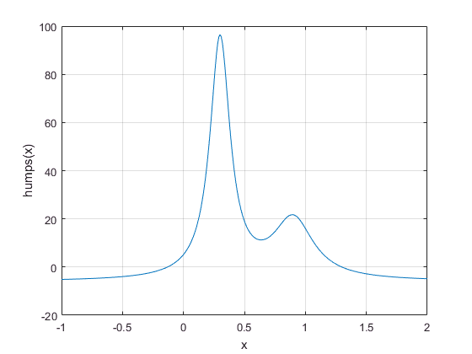
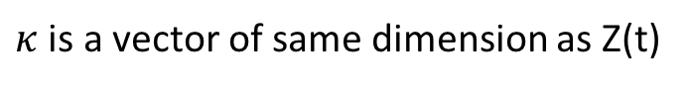
Prophet - Technical Aspects
$h\left(t\right)=Z(t)κ$, $Z\left(t\right)=\left[1\left(t∈D_{1}\right),…,1\left(t{∈D}_{L}\right)\right], D_{i} are holidays$
$κ$ is a vector of same dimension as Z(t)
Capture the special dates with prior knowledge

Slide 13
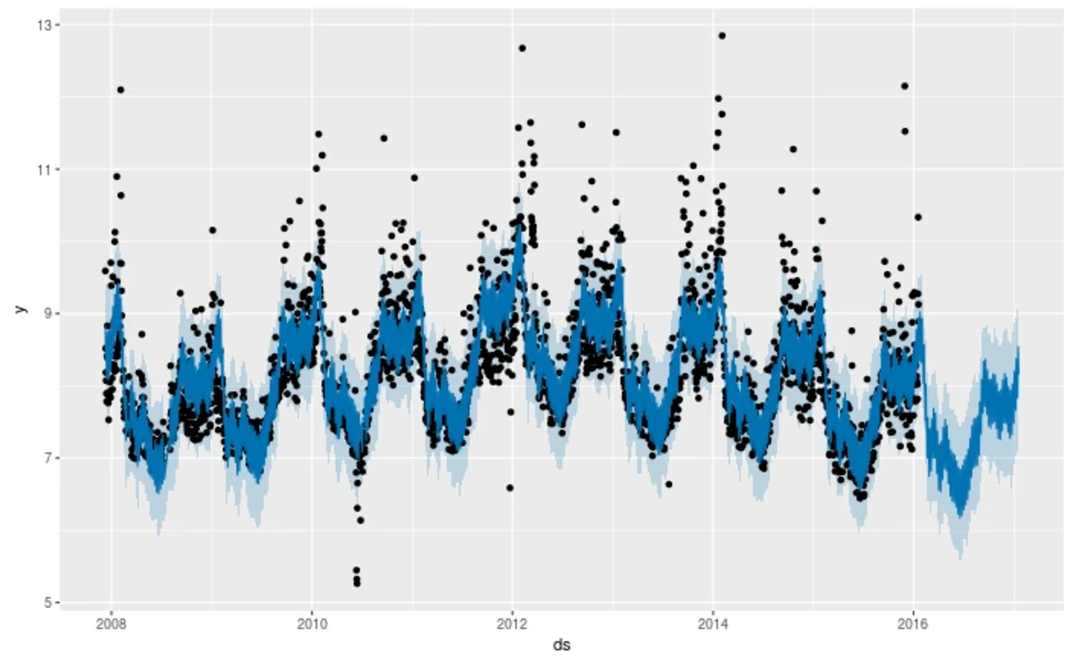
Prophet - Technical Aspects
Fitted Model

Slide 14
Prophet - Evaluation
Suitable scenarios:
Growth Model
Periodic Data
Knowledge of special dates
Limitations in Source Code:
Seasonality feature only provide weekly and yearly option
The complexity of Seasonality is not configurable
(default : 3 & 10 for weekly and yearly)
Computation complexity:
Zero training time. Fast prediction.
Notes:
Prophet used to predict number of Facebook users growth in a region and number of events on Facebook.
Seansonality.
Events and Holidays.

Slide 15
Prophet - For Use Case
Optimized Parameters
n_changepoints
seasonality_prior_scale
changepoint_prior_scale
additional_seasonality
Default Parameters
growth = “linear”
yearly_seasonality = True
weekly_seasonality = True
additional_seasonality_complexity = 5
Unused Parameters
changepoints
holidays
holidays_prior_scale

Slide 16
AutoRegressive Integrated Moving Average (ARIMA)

Slide 17
ARIMA - Overview
Statistical model used for time series analysis and forecasting
Follows the Box-Jenkins approach
Applicable to both, stationary and non-stationary data

Slide 18
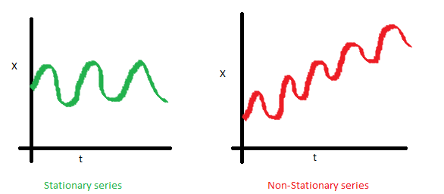
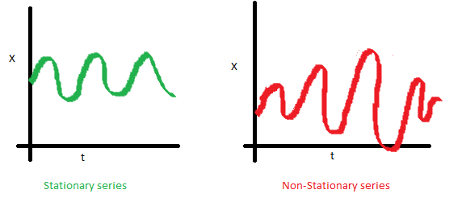
ARIMA - Technical Aspects
Time Series : Stationary vs Non-Stationary
The financial industry is abound with data of varying trends, periodicity, seasonality, volatility etc.

Slide 19
ARIMA - Technical Aspects
ARIMA ( p, d, q )
AutoRegressive (AR)
Current value of variable depends on its previous values with lag p
Integrated (I)
Degree of differencing d to stationarize time series data
Moving Average (MA)
Current value of variable depends on its previous errors with lag q

Slide 20
ARIMA - Implementation
Preprocess Data
Stationarize Data
Prepare Model
Feed processed data
Create ARIMA model and fit curve with training data
Forecast Values
Predict future data points
Minimize loss function by tweaking parameters
Detect stationarity of data
Visual observation, information criterion, Augmented Dickey-Fuller test
Differencing, de-trending & establish optimal parameters
Validate the forecasts with existing test data
Determine trend, period, seasonality

Slide 21
ARIMA - Evaluation
Benefits
Quick computation of results
Suitable for a variety of time series data
Limitations
Establishing parameters is best done manually
May not produce good results in high volatility

Slide 22
Generalized AutoRegressive Conditional Heteroscedasticity (GARCH)

Slide 23
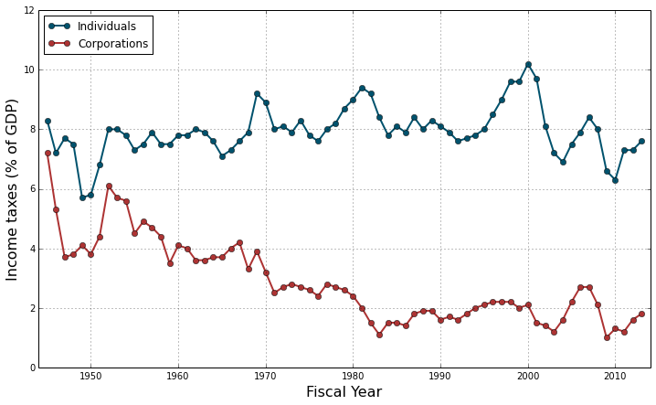
GARCH - Overview
Heteroscedasticity (H)
Variance changes with time.
AutoRegressive Conditional (ARC )
Variance at one period is positively correlated on previous periods’ variance.

Slide 24
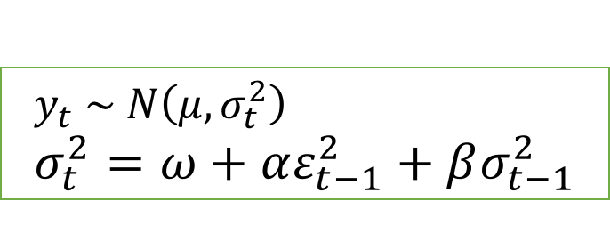
GARCH - Technical Aspects
The GARCH (1, 1) model:
Parameters: Number of lag terms for both error and variance.
$$y_{t} \sim N\left(μ,σ_{t}^{2}\right) \\ σ_{t}^{2}=ω+αε_{t−1}^{2}+βσ_{t−1}^{2}$$

Slide 25
GARCH - Evaluation
Advantages
Suitable to model volatility processes (e.g. return series of a stock)
Quick to compute thanks to recursion
Disadvantages
Does not produce point forecasts

Slide 26



Statistical Models - Implementation
Software
Prophet
Statsmodels
arch
Python
Data Preparation
Numpy
Pandas
26

Slide 27
Neural Networks 101
Notes:
The last two models are based on Neural Networks. And we have spent months before and during this internship to really understand it. But lucky for you we can explain it in just two slides

Slide 28
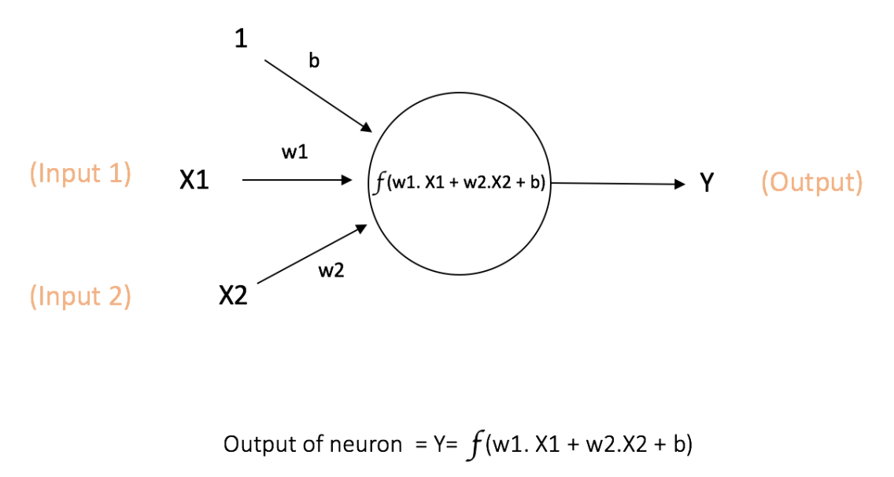
Single Neuron
Notes:
This is a simple structure is called a neuron. It takes input data and performs some weighted computation on it that results in an output. Its supposed to function exactly like a neuron in all our brains.

Slide 29
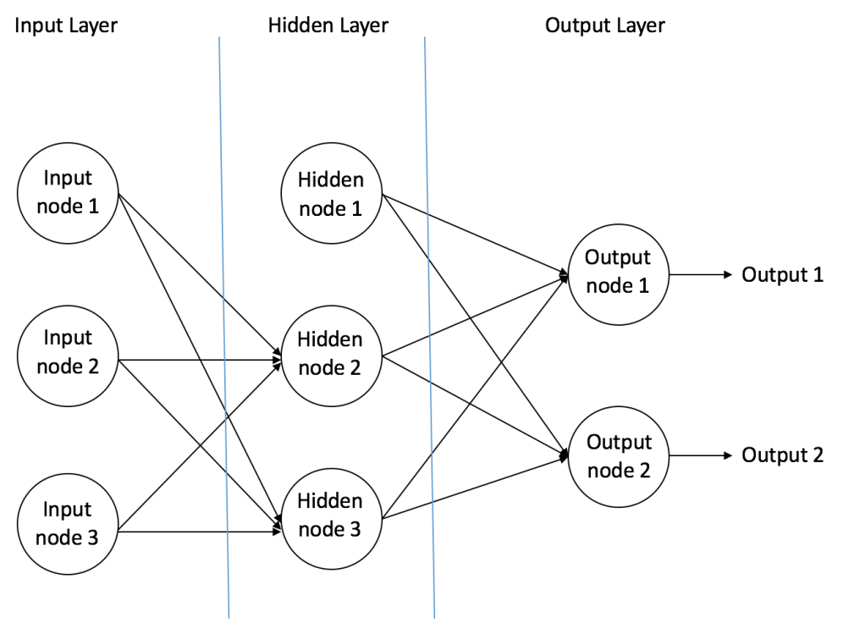
Neural Network
Notes:
Then, you take many such neurons, and arrange them in multiple layers and there you have it, a Neural Network. Each layer performs a certain computation. You have Input Layer, that takes in data, and out put layer that provides the final result. Hidden layers are where the magic happens, and most neural networks differ in the way they perform computations in these layers.

Slide 30
Convolutional Neural Networks (CNN)
Notes:
So moving on to the models, The first is CNN

Slide 31
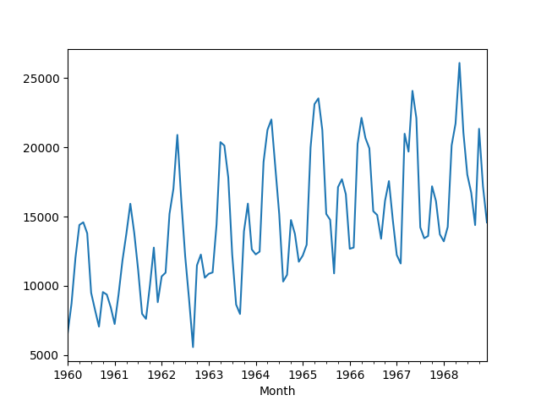
CNN - Overview
Data : Time Series
Convolution Layer
1
Pooling Layer
1
Convolution Layer
2
Pooling Layer
2
Fully
Connected
Data forwarding through different layers
Notes:
This is the general architecture of a Convolutional Neural Network. The input you see is a time series data and it is passed through multiple hidden layers here. There are mainly two such important hidden layers, which you can see are being repeated here simultaneously. They are called Convolution Layers and Pooling Layers.

Slide 32
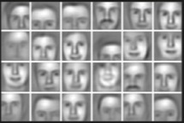
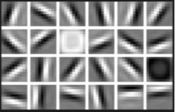
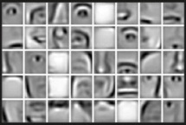
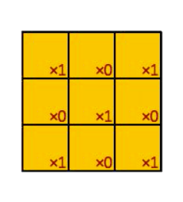

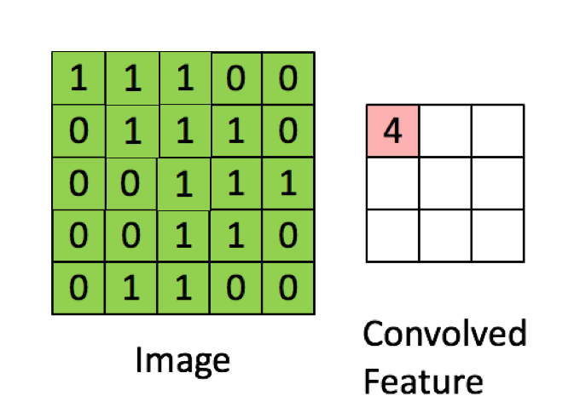
CNN - Technical Aspect
Convolution Layer
Output – Convolved Feature
Extracts essential information from the inputs
Notes:
The convolution layer. Provide its output as a convolved feature. So what is this convolved feature.
You have some data that looks like this matrix here. You take a smaller matrix, call it filter and slide it over this data, doing element wise multiplication at each step.
This is actually extracting essential information from the inputs. In the case of an image of person, the first convolved feature would result in edges and corners. Second, results in recognizable features.
and the third one, you can actually detect faces.

Slide 33
General CNN Architecture
Data : Time Series
Convolution 1

Slide 34

CNN - Technical Aspects
Pooling Layer - Applied to the Convolved Feature
To achieve translational invariance - Small Shifts
Results are usually smaller than the input - Storage/Computation
Notes:
The next layer is a very simple layer callled the pooling layer.
It basically compresses the data by reducing two x two matrix into a single element. The max of the element from coloured squares forms the one element of the output. Helps in achievieng translational invariance which bring stretched trends closer. It also helps in data storage and efficient computation.

Slide 35
General CNN Architecture
Convolution 1
Max Pooling 1

Slide 36
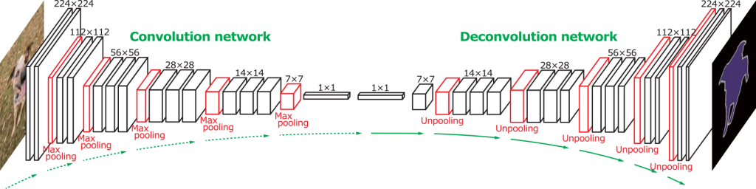
CNN – Technical Aspects
Fully Convolutional Network
Input and Output layers to have the same dimensions
Decoder stage – Un-pooling and De-convolution
Notes:
When you have a task where it is important that the dimensions of the output are same as the dimensions of the input, the architecture is modified to enlarge the data. Its simply reversing the process by unpooling and deconvolution.

Slide 37
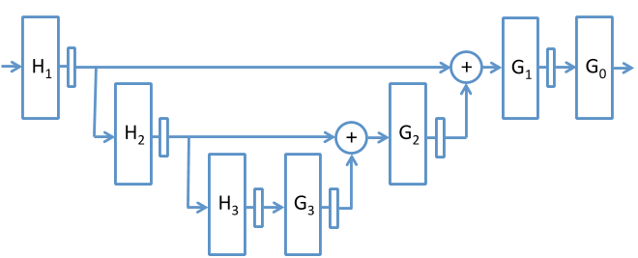
CNN - Technical Aspects
Undecimated Fully Convolutional Neural Network (UFCNN)
UFCNN removes the pooling and un-pooling layers.
Instead, the filters at the l^{th} resolution level are up sampled by a factor of 2^{l} − 1 along the time dimension
Notes:
The previous architecture suffers from strong variations when the input data have small translations. In solving that architectural problem, Undecimated Fully convolutional neural network was adopted. Which follows a method of undecimatedn wavelet transform. Basically, it gets rid of all the pooling and unpooling and only dilates the filters at consecutive layers. Helps in reaching a wider range of time scales.

Slide 38
Summary
CNN - Evaluation
Advantages
Faster than most NN models - Production (GPU) Environment
Individual filters - Provide insight on future predictions
Highly suitable for periodic data - Works as a pattern matcher
Disadvantages
Can be slow to account for very steep change points
Parameter tuning is very difficult
A sub-par filter length can cause loss of essential information
Number of times data is sampled is high (training time)
Notes:
Technical analysis for stock trading
Adv : Quicker than RNN
GPU Infra Each filter provides infor about future
Di
High freq data : Daily

Slide 39
Recurrent Neural Networks (RNN)

Slide 40
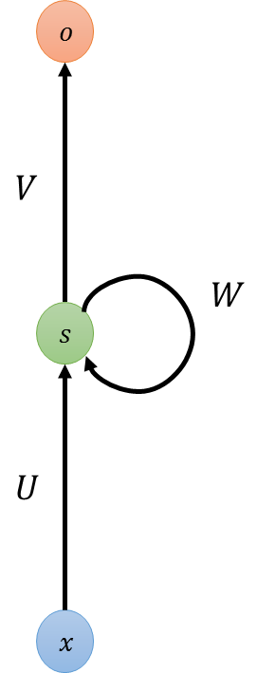


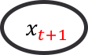


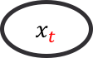
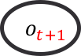

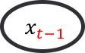

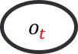


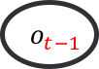
RNN - Motivation
Neural Networks
Recurrent Neural Networks
$$o$$
$$o$$
$$o$$
$$o_{t−1}$$
$$o_{t}$$
$$o_{t+1}$$
...
...
$$s$$
$$s$$
$$s$$
$$s$$
$$s$$
$$s$$
$$s$$
$$s$$
$$x$$
$$x$$
$$x$$
$$x_{t−1}$$
$$x_{t}$$
$$x_{t+1}$$
Inputs and outputs are independent
Sequential inputs and outputs

Slide 41

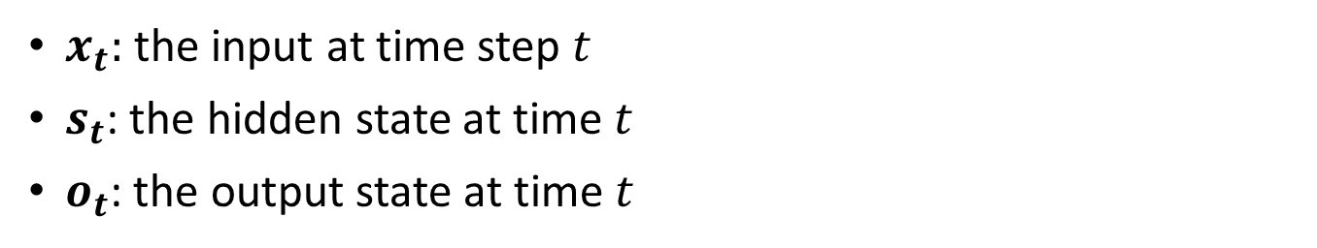
RNN - Overview
RNN has an internal memory to process sequences of inputs.
$x_{t}:$ the input at time step $t$
$s_{t}$: the hidden state at time $t$
$o_{t}$: the output state at time $t$

Slide 42
RNN - Technical Aspects
Standard RNN
The sensitivity of the input values decays over time
The network forgets the previous input
Long-Short Term Memory (LSTM)
The cell remember the input as long as it wants
The output can be used anytime it wants

Slide 43
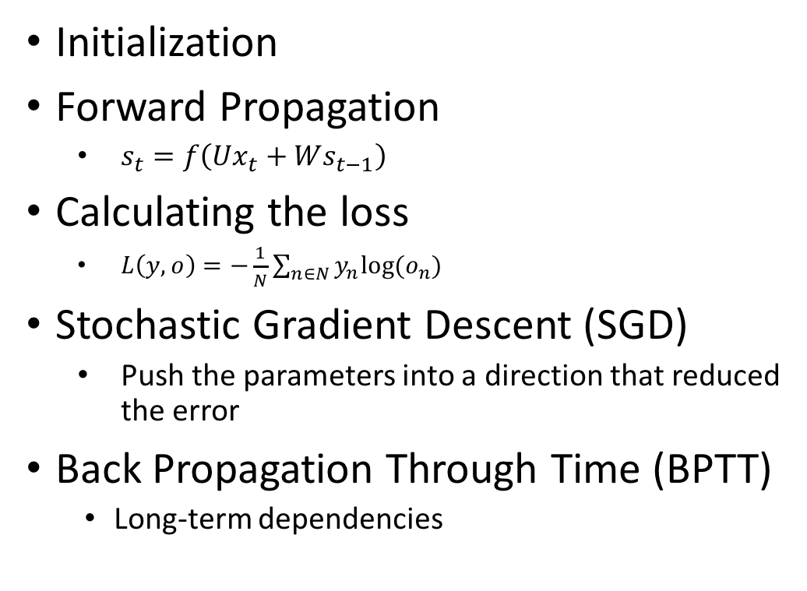
Overall Procedure
Initialization
Forward Propagation
$s_{t}=f\left(Ux_{t}+Ws_{t−1}\right)$
Calculating the loss
$L\left(y,o\right)=−\frac{1}{N}\sum_{n∈N}{y_{n}log⁡(o_{n})}$
Stochastic Gradient Descent (SGD)
Push the parameters into a direction that reduced the error
Back Propagation Through Time (BPTT)
Long-term dependencies
Back Propagation
Through Time (BPTT)

Slide 44

RNN - Technical Aspects
Task | Input | Output
Image classification | fixed-sized image | fixed-sized class
Time-series forecasting | any sequential data | forecast
Sentiment analysis | sentence | positive or negative sentiment
Machine translation | sentence in English | sentence in French
Video classification | video sequence | label each frame

Slide 45
RNN - Evaluation
Advantages
Suitable for sequential data
Highly accurate with proper configuration
Disadvantages
Requires more training time and computation power
Tuning parameters is not straightforward

Slide 46

NN - Implementation
Software
TensorFlow
Python
Numpy
Pandas
Data Preparation
Transform time-series data into batches
Split for training and validation
46

Slide 47
Hyper-parameter Tuning

Slide 48
Motivation
Machine Learning is extremely powerful
Tuning ML systems is extremely non-intuitive
“…We still don’t really know why some configurations of deep neural networks work in some cases and not others, let alone having a more or less automatic approach to determining the architectures and the parameters. “
- Xavier Amatriain, Director of Research at Quora

Slide 49
Tuning Machine Learning Models
Big Data
New Parameters
Optimization
Predictive Models
Better Models
Objective Metric

Slide 50
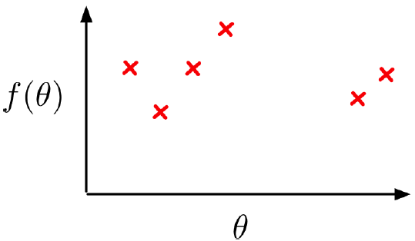
Bayesian Global Optimization
Optimize object function
Loss, Accuracy, Likelihood
Given parameters
Hyper-parameters, feature parameters
Find the best hyper-parameters
Sample function as few times as possible
Training on big data is expensive

Slide 51
How Does It Work?
Build Gaussian Process (GP) with points sampled so far
Optimize the fit of the GP (covariance hyper-parameters)
Find the point(s) of the highest Expected Improvement within parameter domain
Return optimal next best point(s) to sample

Slide 52
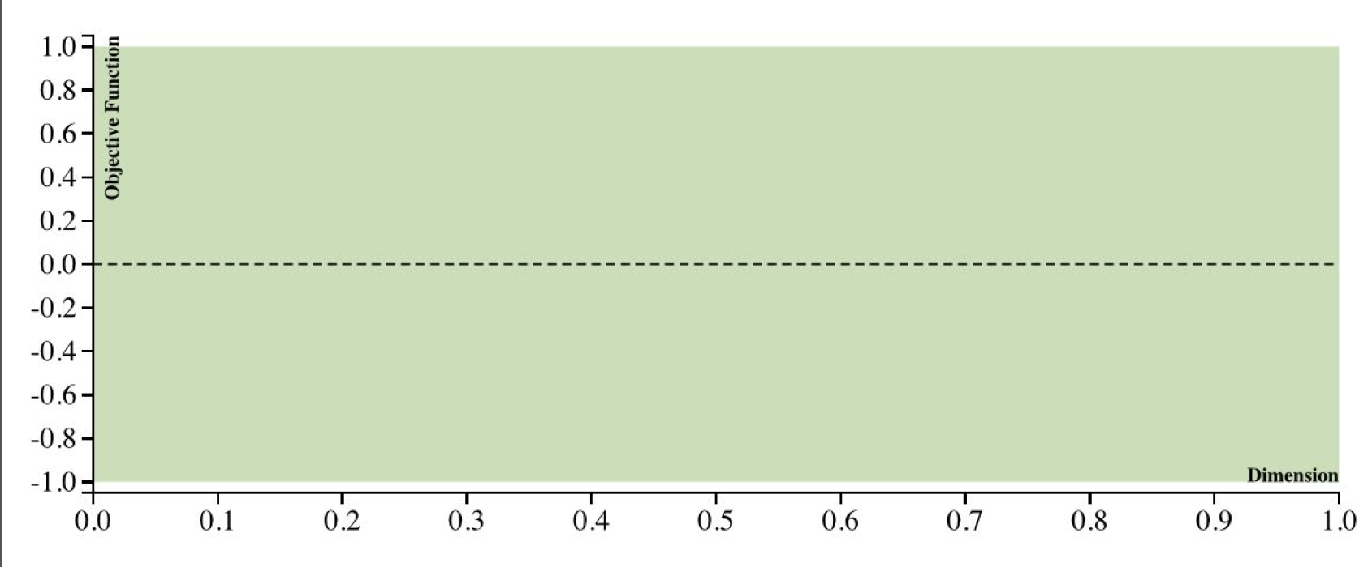
Gaussian Process

Slide 53
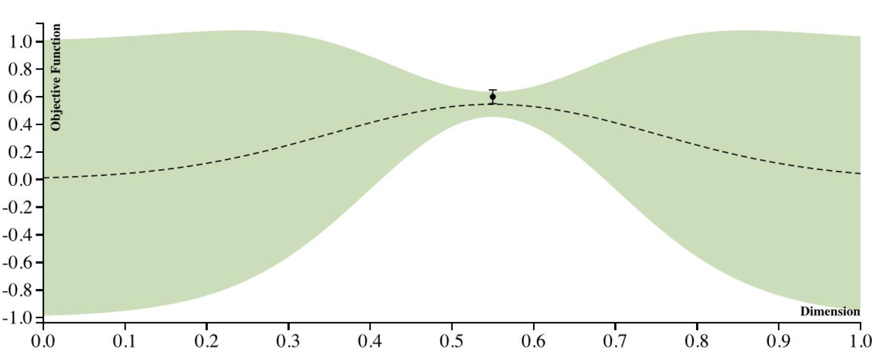
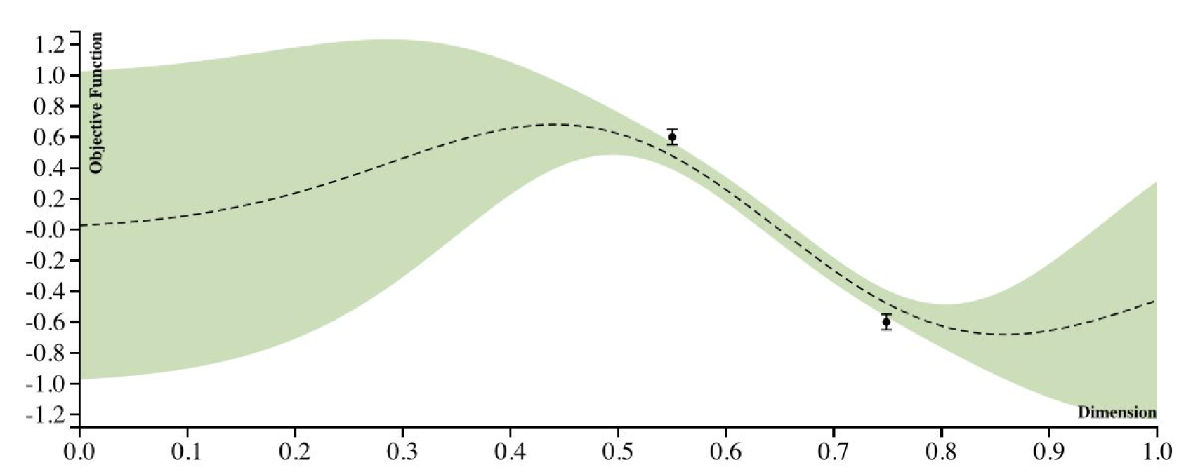
Gaussian Process

Slide 54
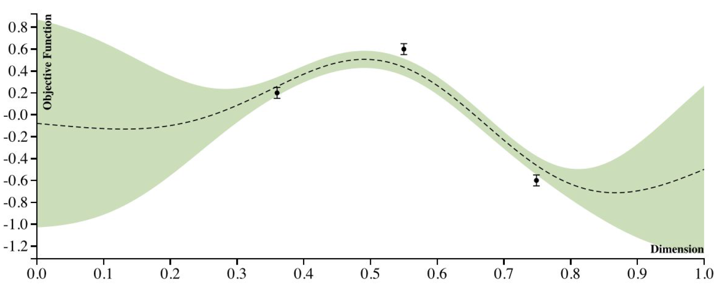
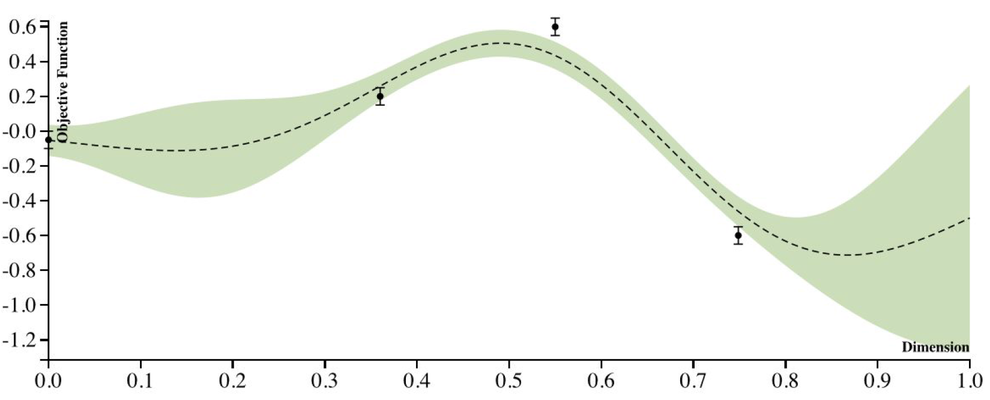
Gaussian Process

Slide 55
Implementation
Bayesian-optimization
https://github.com/fmfn/BayesianOptimization
Define our target function
Define parameters we want to tune
BO will return the optimized parameters
F = (prediction – actual)/actual
Params = {
num_layers: (1, 10)
.. ..
}
BO.maximize(F, params) -> return optimized params

Slide 56
Evaluation
Fast
Quickly optimize objective function
Customizable
Parameters, iterations
More confident in tuning
Integrated into our framework

Slide 57
Use Case

Slide 58

Background
Cash Management
Efficient use of the company’s cash
Viability of using data analytics and machine learning
Data
3 year daily Accumulated Cash Flows
Outcome
Forecasting the future cash flows to provide insight on the client’s operating liquidity requirements
Notes:
Ensure that the cash buffer held by the company is optimized and unused/excess funds are diverted towards reduction of leverage and short term investments

Slide 59
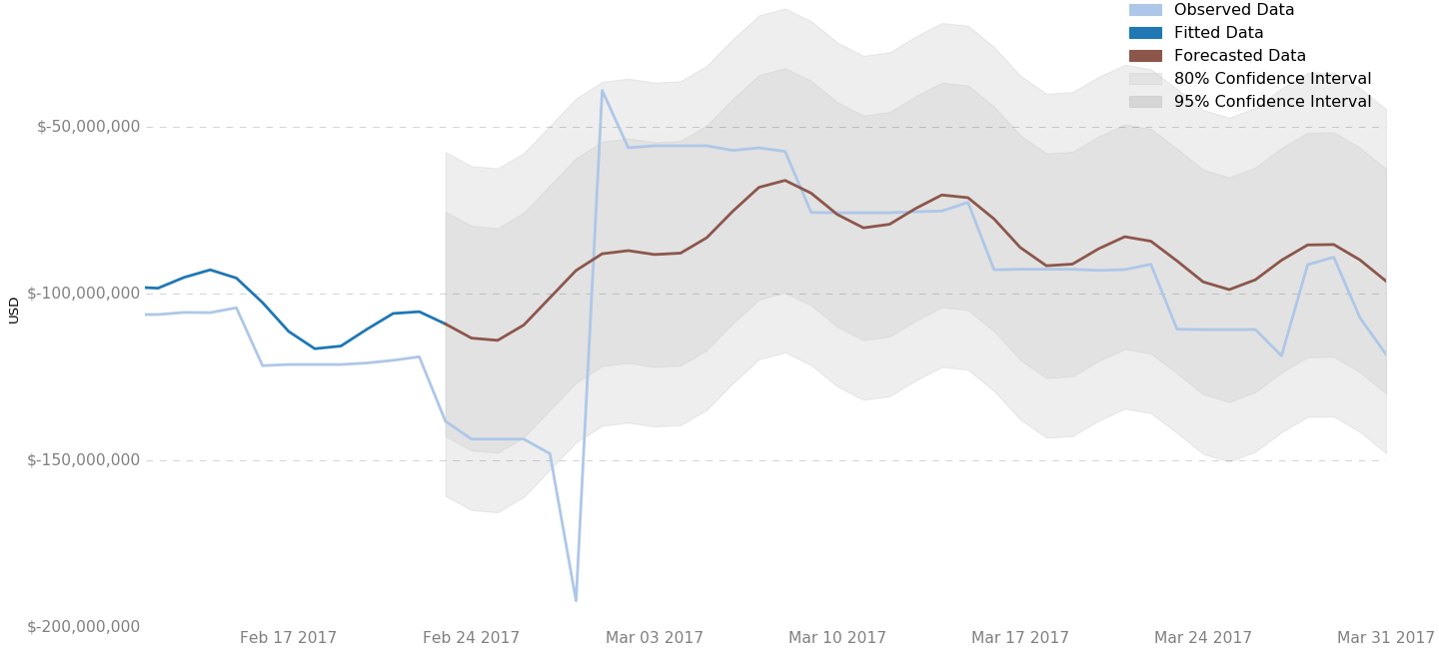
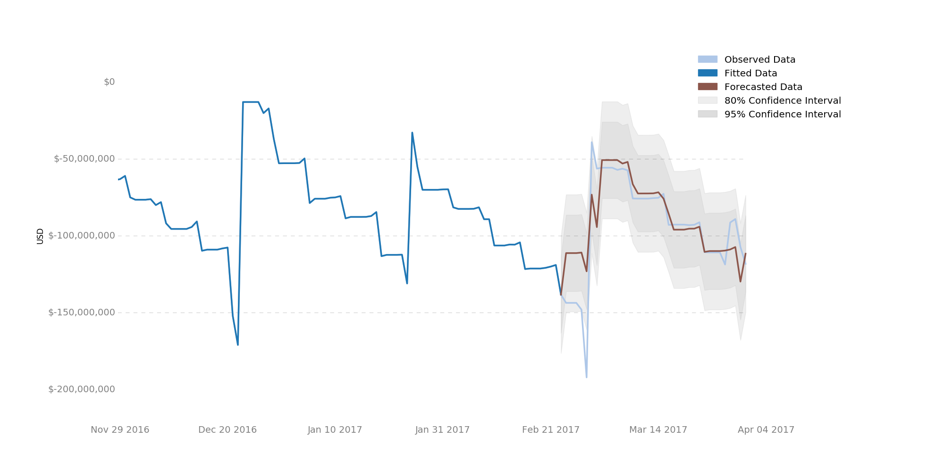
Visualization
Prophet
ARIMA

Slide 60
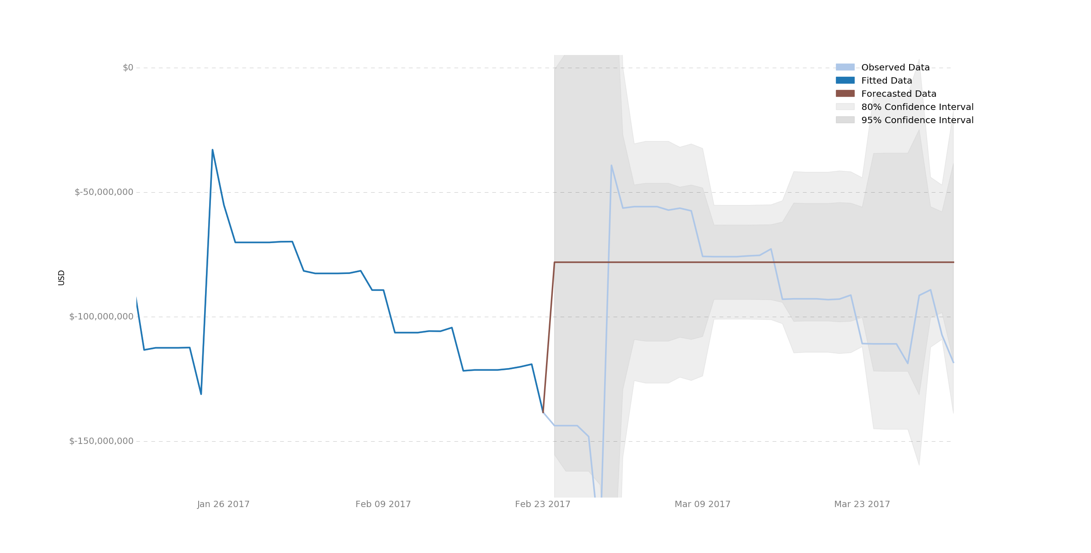
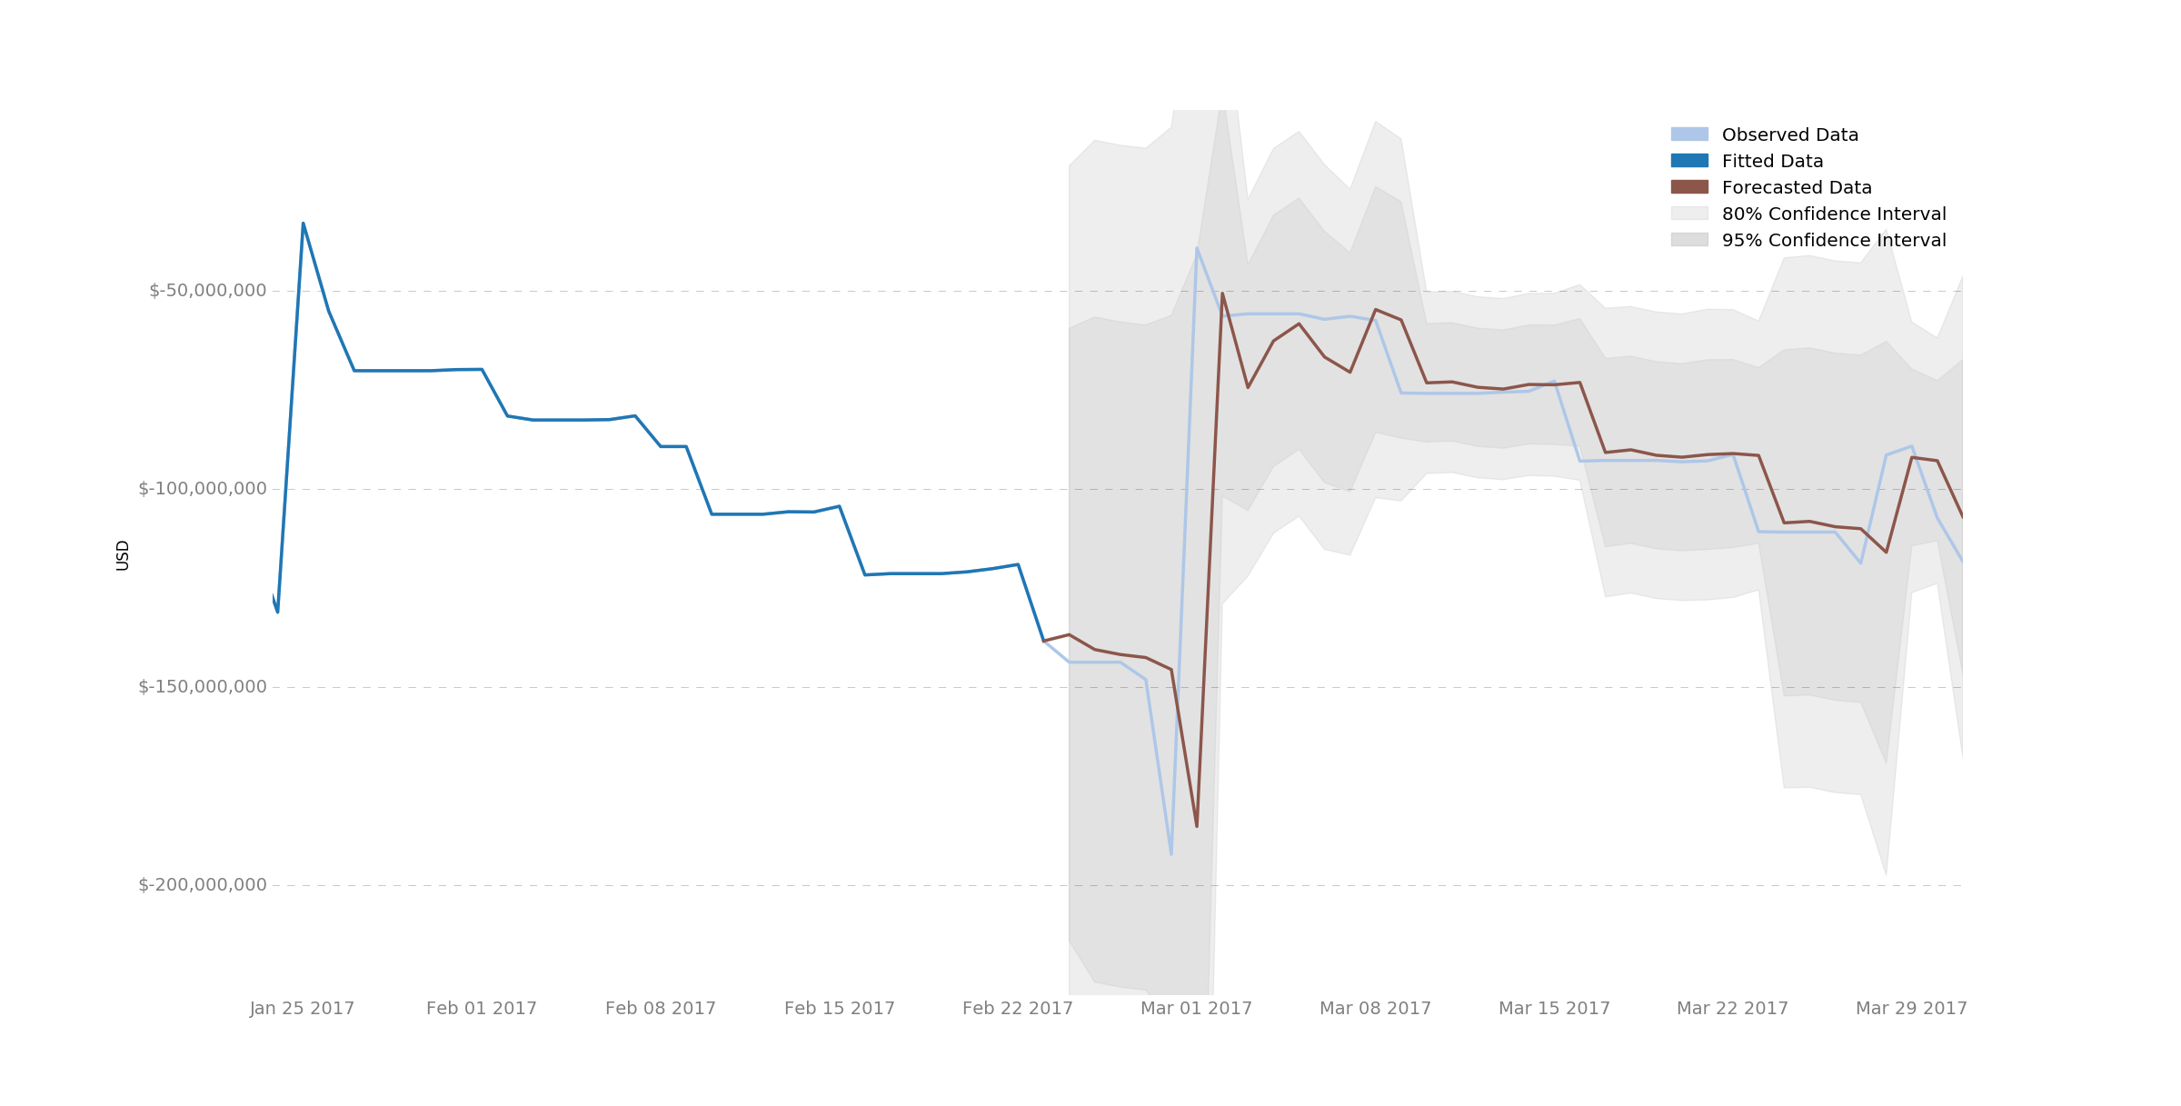
Visualization
GARCH
ARIMA-GARCH

Slide 61
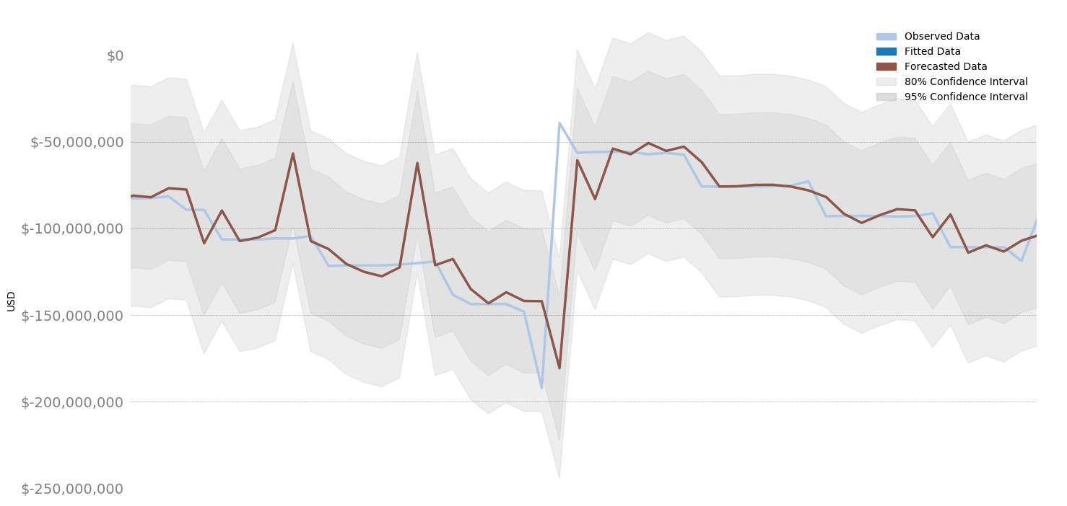
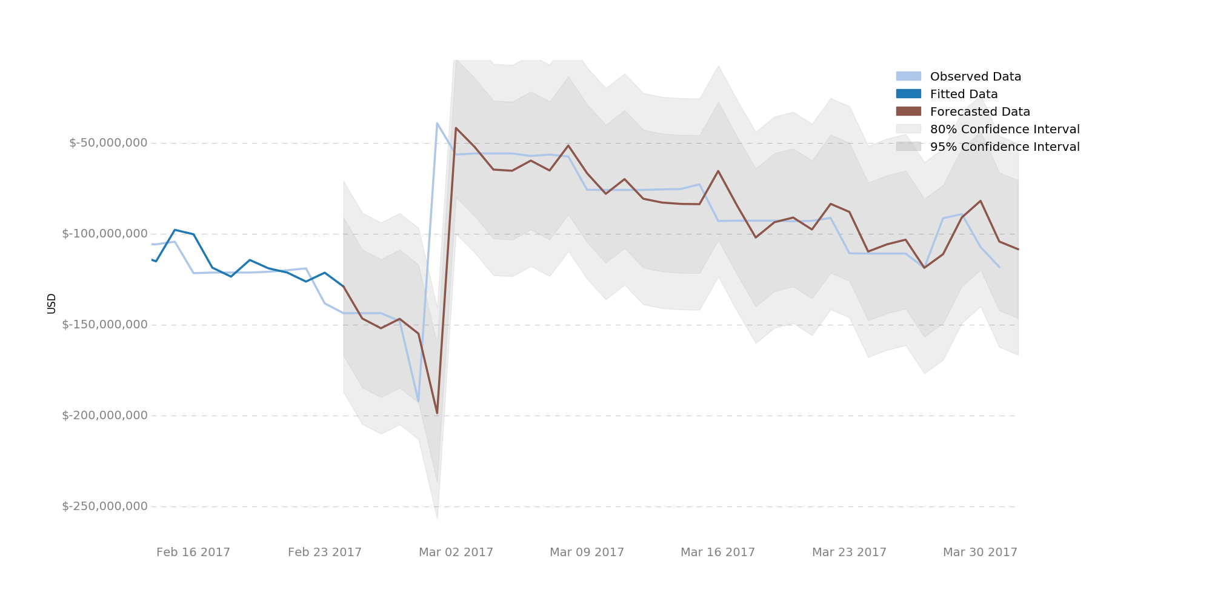
Visualization
UFCNN
RNN

Slide 62
Benchmark – Root Mean Square Error

Slide 63
Benchmark – Mean Absolute Percentage Error

Slide 64
Benchmark – Training Time
Model | Time
Prophet | ~ 5 Seconds
ARIMA | ~ 3 Minutes
GARCH | ~ 1 Minute
UFCNN | ~ 45 Minutes
RNN | ~ 16 Minutes
All predictions are almost instantaneous

Slide 65
Take-away

Slide 66
Conclusion
Performance
For this use case, best performing model is RNN
With GPU infrastructure, UFCNN has potential
Prophet can be improved with analyst’s domain knowledge
Suitability
All models are suitable for time-series forecasting
Machine learning models can be easily applied to other use cases
Deep learning models need to be retrained for specific tasks

Slide 67
Project Management
Plan
Early schedule
Weekly catch-up with manager
Communication with stakeholders
Knowledge sharing
Mini workshop and talk
Resource sharing
Task and issue tracking
JIRA
Scrum board
Vertical slice

Slide 68
Vertical Slice
All member of the team can
Research
Applying new ideas
Develop
Test
Code review
Writing documents
Deploy

Slide 69
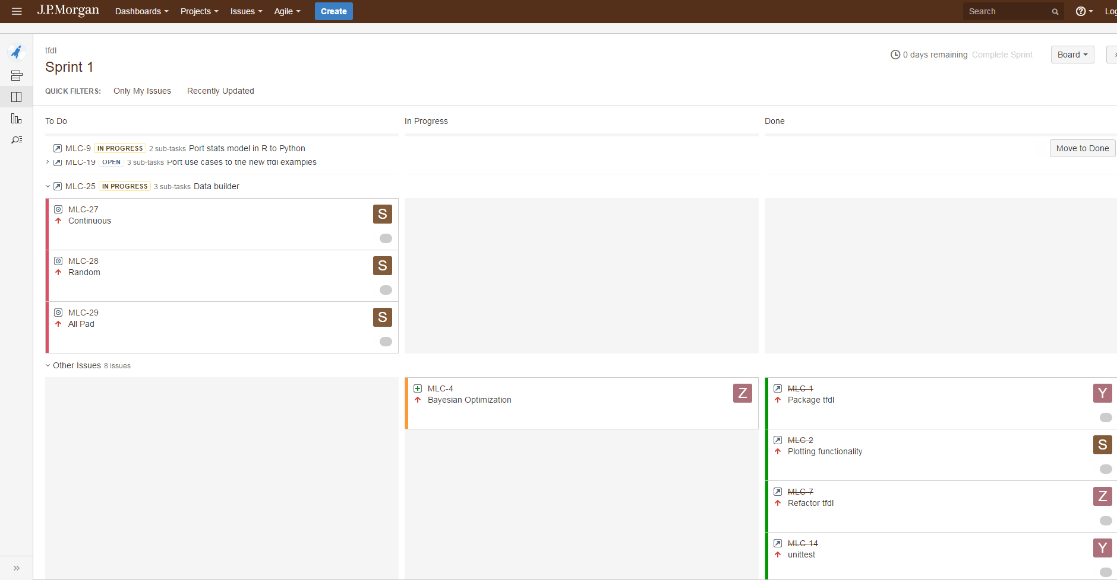
Scrum JIRA Board

Slide 70
Contributions
Python package
5 configurable models
Automatic hyper-parameter tuning
Forecast visualization
Documentation of the models for guidance for future works
In process of publishing the package to JPMOSS

Slide 71
Q & A

Slide 72
Thank you!
A special thanks to our managers and mentors for your guidance throughout the course of this project

Slide 73
Additional Slides

Slide 74
Resources
Prophet
https://facebookincubator.github.io/prophet/
https://github.com/facebookincubator/prophet
ARIMA
http://www.statsmodels.org/dev/tsa.html
http://machinelearningmastery.com/arima-for-time-series-forecasting-with-python/
GARCH
http://www.github.com/bashtage/arch
UFCNN
https://arxiv.org/abs/1508.00317
RNN
http://tensorflow.org

Slide 75
What stakeholders will receive
Forecast results (excel sheet and visualization image)
e.g. forecasted by RNN Model
Training report
Prediction visualization
RMSE, MAPE…
Date | Forecast CF | 90% Confidence Interval | 75% Confidence Interval
2017-07-19 | 163547461 | (-313k, +213k) | (-233k, +182k)
2017-07-20 | 386449853 | (-241k, +233k) | (-121k, +92k)
… | … | … | …

Slide 76
Timeline
Week 2: Understand the problem statement
Week 3-5: Five models can produce prediction results
Week 6-7: Optimization of five models
Week 8: Wrapping up, Visualization, Benchmarking, Documentation

Slide 77
Prepare the time series data
Raw data
(100%)
Train
(95%)
Test
(5%)
Train
(95%)
Validation
(5%)
Test
(5%)
90.25%
4.75%
5%

Slide 78
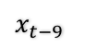
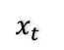
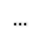
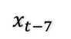

Prepare the time series data
x #01
[1, 2, 3, …,10]
split_squeeze
1
2
3
…
10
$$x_{t−9}$$
$$x_{t−8}$$
$$x_{t−7}$$
$$…$$
$$x_{t}$$

Slide 79


Long Short-Term Memory (LSTM)

Slide 80
Future Improvement
Train our models using GPU infrastructure
Produce interactive browser compatible visualization results to our stakeholders
Provide API for external applications

